Slide 1

Compatible platforms
3S SARS-CoV-2
RT-PCR Kit
MIC, Bio Molecular Systems
CFX96, BioRad
Rotor-Gene Q, Qiagen
ABI 7500 FAST, ThermoFisher
LightCycler480, Roche
Sample types
Nasopharyngeal
oropharyngeal swabs
Other CDC recommended sample types
Kit information
2003241: 3S SARS-CoV-2_V1 (50 tests)
2003242: 3S SARS-CoV-2_V1 (100 tests)
Increased sensitivity: 10 copies /reaction (2 copies/µL)
Increased specificity: No cross-reactivity with other respiratory pathogens.
Speedy detection: From RNA to results less than 2 hours
Multiplex: Enables simultaneous detection of two SARS-CoV-2 specific signature regions in a single reaction.
Enables detection of human housekeeping gene as an Internal Control (IC).
Contact information
TR1@gis.a-star.edu.sg
Translational Research 1,
Genome Institute of Singapore , A*STAR

Slide 2

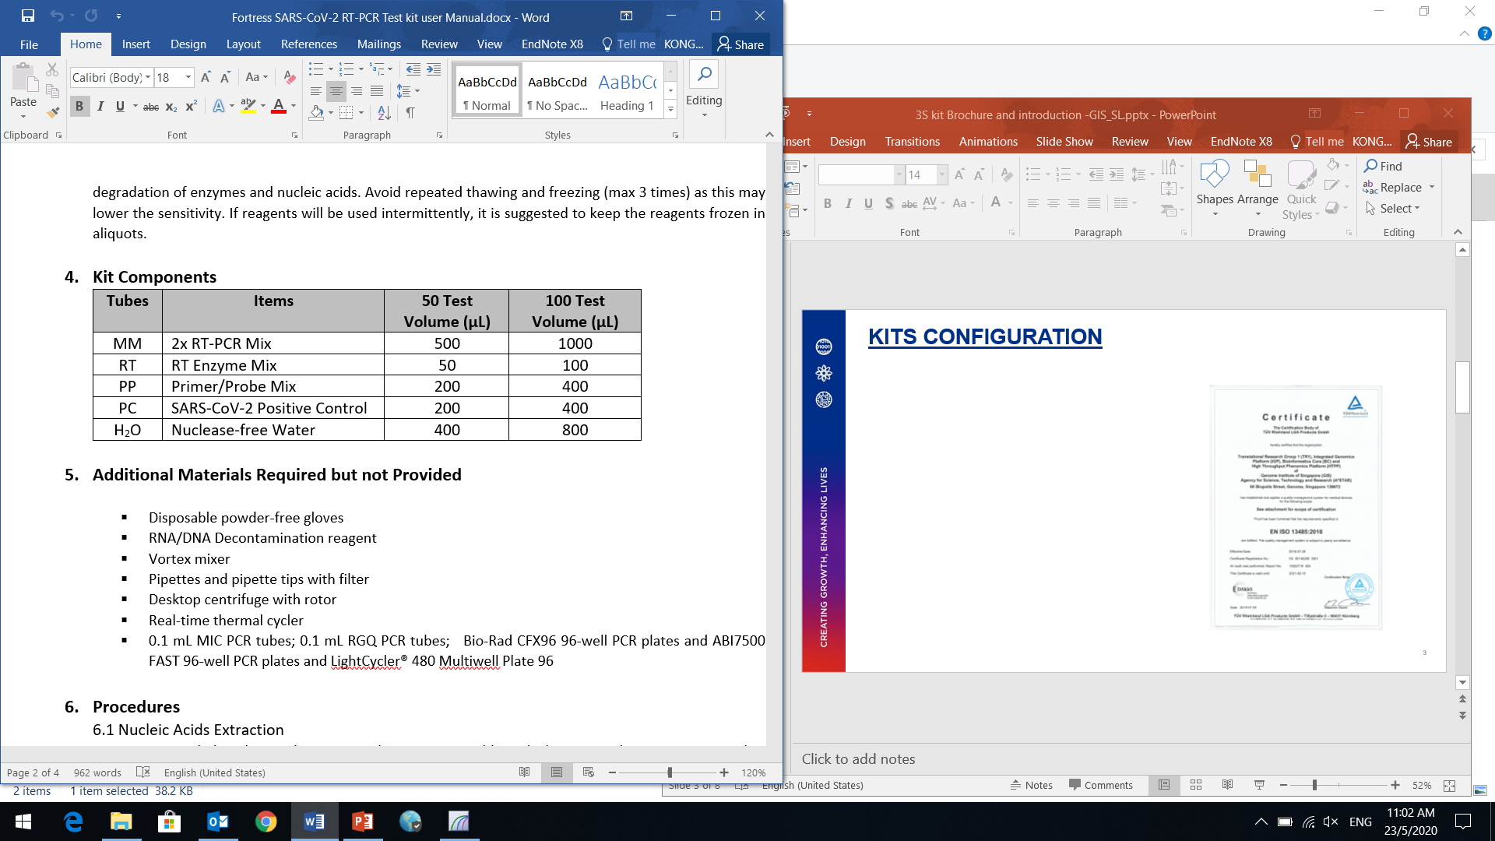
KITS CONFIGURATION
Kit is manufactured following the ISO 13485 regulation.
2

Slide 3
PRODUCT INFORMATION
Two SARS-CoV-2 specific signature regions: ORF1ab gene, N gene
Internal Control: human housekeeping gene as an Internal Control (IC) to identify possible PCR inhibitions from sample processing.
Throughput per run:
94 samples + 1 PC+ 1 NC (BioRad, CFX96)
94 samples + 1 PC+ 1 NC (ThermoFisher, ABI7500 FAST)
94 samples + 1 PC+ 1 NC (Roche, LC 480)
70 samples + 1 PC+ 1 NC (Qiagen, Rotor Gene Q)
46 samples + 1 PC+ 1 NC (Bio Molecular Systems, MIC)
3

Slide 4
NUCLEIC ACID EXTRACTION
RNA extracted by Qiagen QIAamp Viral RNA Mini Kit and other kits recommended by CDC.
Automatic RNA extraction by Qiagen EZ1, MGI-SP960 and other CDC recommended equipments.
Extracted RNA to be tested immediately, otherwise, -80 °C storage condition will be recommended.
4

Slide 5
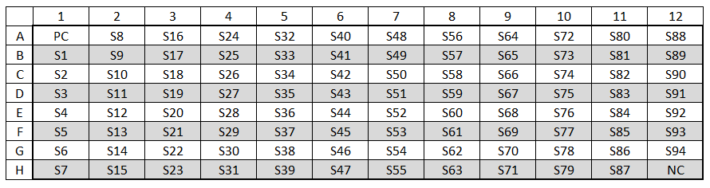
ASSAY SET UP
Reagent preparation
Plate layout
5

Slide 6
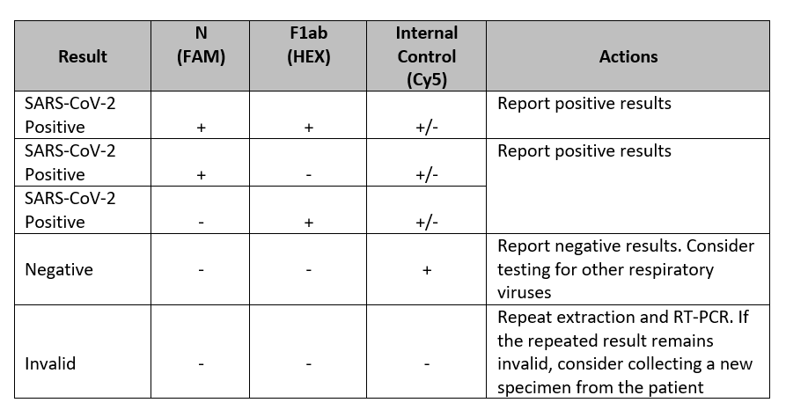
INTERPRETATION OF DATA
A sample will be detected as positive with SARS-CoV-2 if there is amplification signal from either FAM or HEX or both channels. The interpretation of data can be done as follows:
6

Slide 7

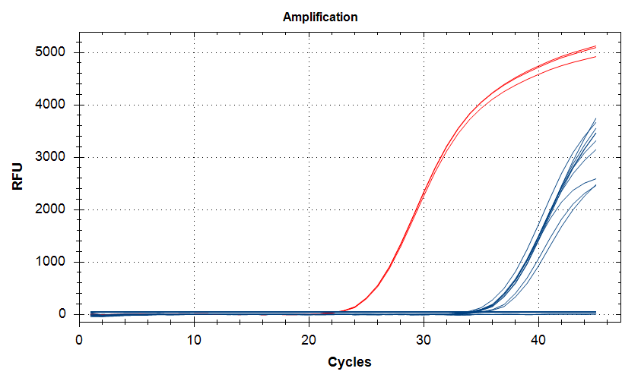
TEST PERFORMANCE
Good specificity with absent of amplification in other respiratory disease pathogens.
Good analytical sensitivity with detection limit of 10 copies.
3S kit:
control sample (33333 copies) = 22.45
control sample (10 copies) = 34.34
no template control = not detected
7

